Slide 1


Eff {Strings}
Amber
Christian
Ishmael
Steve

Slide 2
Background
Last.fm is a global application created in the UK by founders in Germany and Austria in 2002
that builds a profile of users’ musical taste based on the songs a user listens to on internet
radio, their PC, or other portable music devices.
Last.fm CEO has tasked music supervisors with recommending and selecting appropriate
music and licenses to provide on their app.
Music Supervisors are analyzing global music data against Gross National Product (GNP)
To determine whether economic indicators affect listeners and play counts. This
information will inform the most profitable music selections globally, providing guidance
to inform Music Supervisors’ selection criteria.
“Music is life itself.”
-Louis armstrong

Slide 3
Hypothesis
Null Hypothesis:
GDP has no relationship to listeners.
Alternative Hypothesis:
If GDP is lower, Last.fm will have a higher listenership.
“Imagine”
John Lennon

Slide 4

Data approach:
ISP3166 – country names
LastFM API
Top 50 Artists for each Country
Artist
Genres
World Population Review – GDP
Latitude and Longitude
‘music is the only thing I’ve ever known that doesn’t have any rules at all”
-josh homme

Slide 5
Limitations
No time frame or trending ability
Of all music sources, we are looking at one source
Listeners vs. population
No demographic population
Manual cleanup of data was necessary
API documentation appeared to be dated
"Hey Jude, don't make it bad. Take a sad song and make it better"
-The Beatles

Slide 6
Questions
Which artist are most popular based on their country play count?
Which countries’ users engage the most with the app?
Who are the top artists in the country with the highest listener count?
What is the average replayability globally? (With over 1 Million listeners)
Who are the top 5 artists globally?
What is the GDP and play count of each country?
“Wake me up when September ends”
Green day

Slide 7
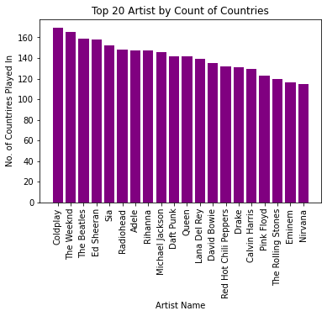
Which artist are most popular based on their country play count?
Data demonstrates that:
Coldplay
The Weekend
The Beatles
Ed Sheeran
Sia
Radiohead
Adele
Data shows how often artists are listened to regardless of listener (or user)
“I will try to fix you”
-coldplay

Slide 8
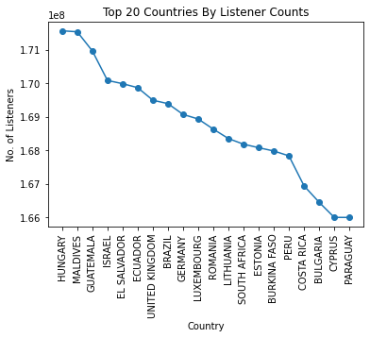
Which countries’ users engage the most with the app?
Hungary has the most users engaged as a sum of listener count with the app, followed closely with Maldives.
Followed by
Guatemala
Israel
El Salvador
Ecuador
United Kingdom
“music produces a kind of pleasure which human nature cannot do without”
-Confucius

Slide 9

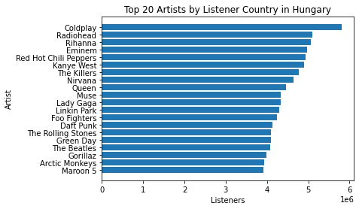
Who are the top artists by listener count in the country with the highest overall listener count (Hungary)?
The top artists listened to in Hungary, which has
the highest listener (or user) count, are:
Coldplay
Radiohead
Rihanna
Eminem
Red Hot Chili Peppers
This sets a standard for other countries.
“If music is a place, then jazz is the city, folk is the wilderness, rock is the road, classical is a temple.”
-vera nazarin

Slide 10
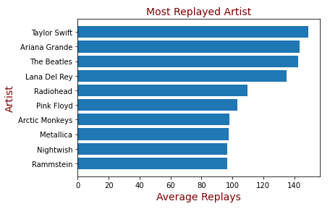
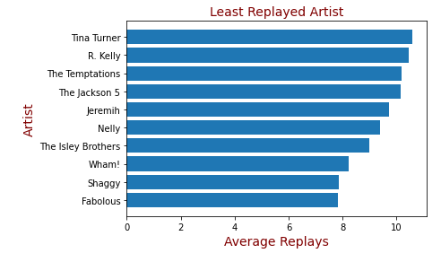
What is the average replayability globally? (With over 1 Million listeners)
“one good thing about music, when it hits you, you feel no pain.”
-bob marley

Slide 11
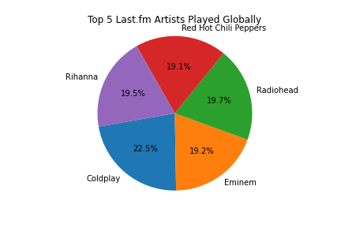
Which 5 artists are played most often globally?
Top 5 artists that are played the most globally are:
Coldplay
Radiohead
Rihanna
Eminem
Red Hot Chili Peppers
This provides us with examples of genres to seek out.
“Bye Bye Miss American pie”
-Don Mclean

Slide 12
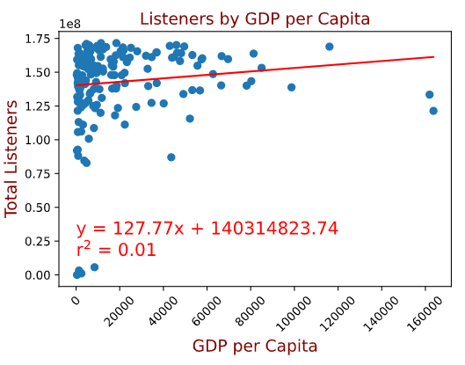
What is the GDP and play count of each country?
Null Hypothesis:
GDP has no relationship to listeners.
Alternative Hypothesis:
If GDP is lower, Last.fm will have a higher listenership.
We can conclude that there is no relationship between country GDP per capita and listenership.
Therefore we can fail to reject the null hypothesis.
“you got to know when to hold em, know when to fold em, know when to walk away”
-Kenny rogers

Slide 13
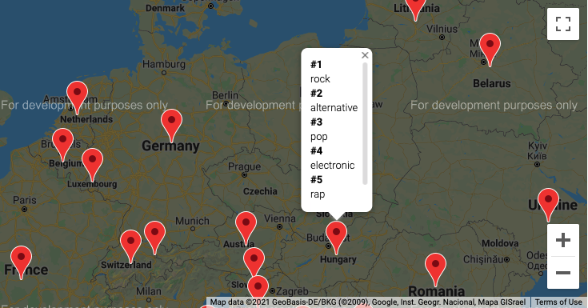
Bonus- Genre Searcher
Looking at country, you can find the top 5 genres.
“What a wonderful world”
-louis armstrong

Slide 14
Lessons Learned
More decisiveness in selection of data
Data sets were better for application development rather than data science
Understanding and agreeing on the ask
More frequent communication
“school’s out for summer”
-alice cooper

Slide 15
Credits
Written by: Amber W., Steve W. , Christian L., & Ishmael S.
Performed by: Eff{Strings}
Produced by: CIAS
THANK YOU!!!
“I hope you had the time of your life”
-Green day

